Slide 1
ALAT
A new authoring environment
Notes:
Thank everyone for coming.
Result of 6m project
If not explained: explain format of defense.

Slide 2
The project context
Introduction to Adaptive Hypermedia
Related work
ALAT
Conclusions & Future work
ALAT: A new authoring environment

Slide 3


The project context
Collaboration between TU/e and “De Roode Kikker”.
TU/e goal: More research and use of GALE.
“De Roode Kikker” goal: Add adaptivity to existing
e-learning platform.
Opportunity: a new authoring environment.
ALAT: A new authoring environment
Notes:
Combining resources/specialities
Name goals of both parties
Opportunity taken because: Meetings for fresh ideas, multiple disciplines

Slide 4
What is Adaptive Hypermedia?
Adaptivity:
“The state or quality of being adaptive; capacity to adapt.”
Hypermedia:
“An extension of the term hypertext, is a nonlinear medium of information which includes graphics, audio, video, plain text and hyperlinks.”
ALAT: A new authoring environment
Notes:
Hypermedia: aka: “Stuff we can see and interact with in our internet browsers.
So: Browser content which adapts.

Slide 5
Adapt to what?
Previously visited pages
Number of page visits
Time spent visiting pages
Test results
User profile
Notes:
User profile can be filled in by the adaptive system itself or externally from some other data source

Slide 6
How does this work?
Adaptive Hypermedia Systems
GALE (Generic Adaptation Language & Engine)
A web server which performs adaptivity
Adaptive applications
Notes:
GALE is the TU/e standard adaptive hypermedia platform.
Developed in GRAPPLE project. Collaboration with European partners both industrial and academic. 2008 to 2011
Gale runs “adaptive applications”

Slide 7
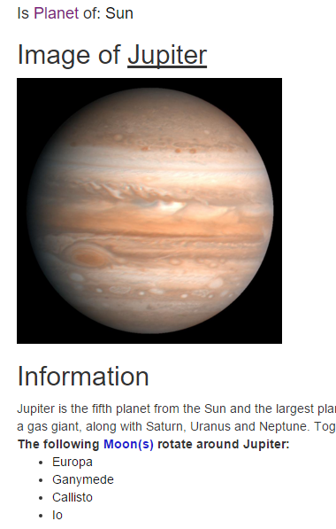
Adaptive applications
Domain model (DM)
Concepts
Attributes & Parameters
Non-pedagogical relations
Adaptation model (AM)
Adaptation rules
GAM code
Unary (Visited counter)
Binary (Prerequisite)
Notes:
Adaptive applications consist out of DM + AM.
Name examples of DM items, Att/params: name, web resource, category. Non-pedagogical rules: parent/child or functional: Moon rotatesAround earth.
AM

Slide 8
Authoring
“The Achilles heel of Adaptive Hypermedia”
Complicated
Tedious
Might hinder widespread uptake
Notes:
Complicated: Rules are in code very technical. Large applications become unmanageable.
Tedious: Lot of repeated behavior. This results in a lot of dumb labour.

Slide 9
The solution: Authoring Tools
Notes:
Take away complexity from the user. Makes designing easier. Generate applications based on design.

Slide 10
The current tool for GALE: GAT
GRAPPLE Authoring Tool
Created by multiple parties
Unfortunate design decisions
Notes:
Current authoring tool for GALE
Some unfortunate design decisions taken due to multiple project partners

Slide 11
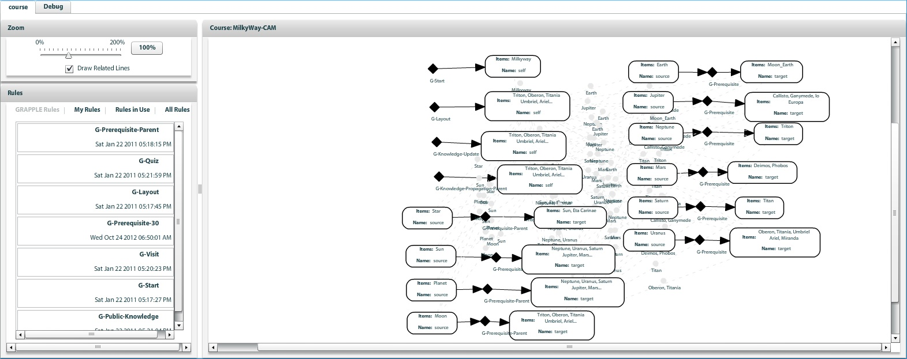
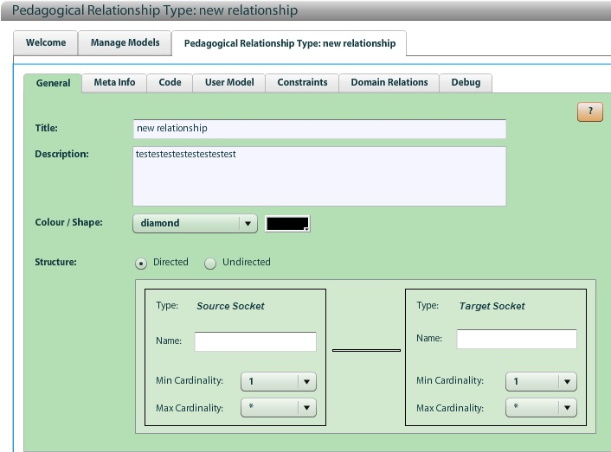
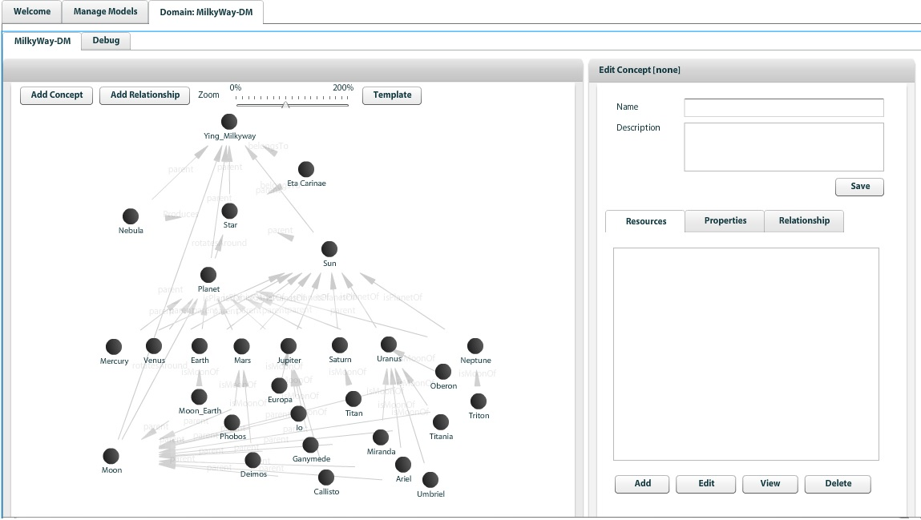
3 tools in 1
Notes:
3 tools: DM, AM, new rules. Context switching is a big issue.

Slide 12
Domain designer tool
Notes:
DM design:
Cluttered interface.
Clumsy controls.
Information divided over lots of screens.
Adding concepts and relations involves various pop up windows
selection boxes containing huge lists.

Slide 13
Course designer tool
Notes:
AM design.
Graph interface seems impractical.
If domain changes, other tool is needed
Big lists when selecting.
Cluttered, graph does not make a lot of sense
Way of thinking. First Rule, then concepts -> STRANGE

Slide 14
Pedagogic Relation tool
Notes:
- Make new adaptation rules.
Actually pretty useful
No easy lookup, copy/paste from existing rules. Is this really better than editing configuration files?
Conclude GAM discussion

Slide 15
Other state of the art tools
Notes:
A look at other state of the art tools to discover what these tools do different

Slide 16
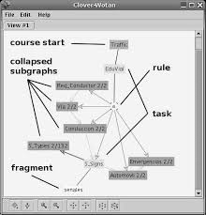
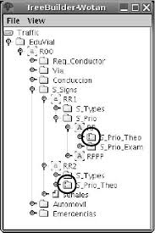
WOTAN
Notes:
Graph interface attempt.
Complicated interface design
DM + AM in 1 model causes for redundant information/interface cluttering
Lesson: separation of concerns is important, Graph interfaces are extremely difficult to properly use

Slide 17
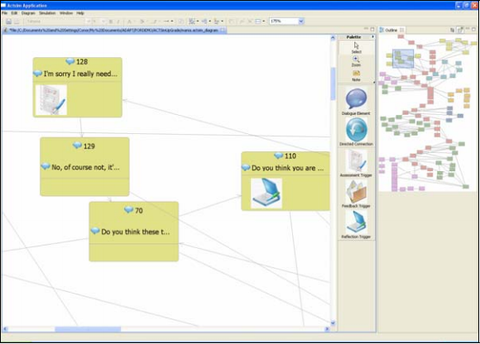
ACTsim
Notes:
Soft skills emulation made adaptive
Educational simulations. Limited scope
Easy to use
Lesson: Tradeoff Genericity – Service/usability

Slide 18
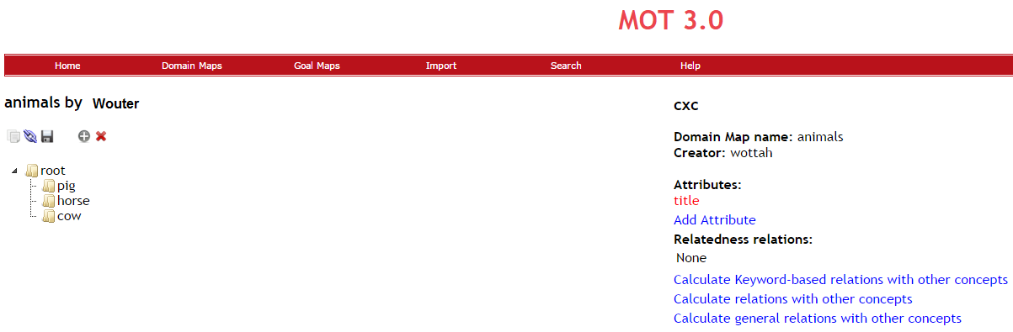
MOT 3.0
Notes:
Focused heavily on separation of concerns
Designed to have multiple users work on different aspects of authoring
Separate (code) editor to introduce adaptation code
Lesson Separation of concerns vs usability

Slide 19
ALAT
“Adaptive Learning Authoring Tool”
Generic
Easy
Fast
Notes:
Main features I will be discussing: The interface design/ application workflow AND the extensive templating which makes it so generic.

Slide 20
Genericity through templating
Concept blueprints
Adaptation rules
JSON files server side
Notes:
Great strength of ALAT is templating.
All rules / concept blueprints from templates.
JSON format for easy read/write and native parsing.

Slide 21
Concept blueprints
Introduces standard behavior
Rules
Attributes
Default attributes
Notes:
Gives new concepts standard behavior: Rules and attributes. ALSO defines attributes over all concept types (used for layouts in GALE.) prevents having to declare them for every concept.

Slide 22
{ "defaultAttributes":[ { "name":"suitability", "type":"Boolean", "value":"true" }, { "name":"knowledge", "type":"Double", "value":"0", "operator":"AVG" } ], "conceptTypes":[ { "name":"text-topic", "default_attributes":[ { "name":"info", "type":"String", "value":"This is some basic concept information text!" } ], "default_rules":[ "own knowledge update", "visited", "knowledge_update" ] } ] }
Notes:
Explain attributes and objects.
Note this does not contain rule definitions

Slide 23
Relation definitions
Contains all Pedagogical relation definitions
Adaptation rules
reusable
Tooltips for usability
Adaptation rules on default attributes
Adaptation rules on other attributes
Default non-pedagogic relations

Slide 24
{
"def_att_rules":[ { "name":"hasPrerequisite", "type":"binary", "target":"suitability", "tooltip":"Target concept must be learned before source is recommended.", "code":"${%target%#knowledge} > 0.8", "operator":"and" } ], "persistent_att_rules":[ { "name":"visited", "type":"unary", "properties":[ { "name":"visited", "type":"Integer", "defval":"" } ], "tooltip":"stores number of concept visits in ‘visited’", "code":"#[visited]:Integer event +`if (${#suitability}) { ${#visited}++;}`" } ], "def_relations":[ { "name":"rotatesAround", "tooltip":"source concept rotates around the target object." } ] }

Slide 25
Interface and workings – Live Demo

